Slide 1
Executive Summary
Business plan presentation

Slide 2
Introduction
Taylor’s HR SAP Project
This is an executive summary presentation
Presented by ____ (Data Analyst)

Slide 3
Customer and Industry Context
Challenges faced
Vision to be the market leader and one of the best employers in the region
Key focus on staff retention and development in a highly competitive sector
Goals around improving employee efficiency, productivity, and satisfaction
Desire to drive continuous improvement of HR competencies and systems

Slide 4
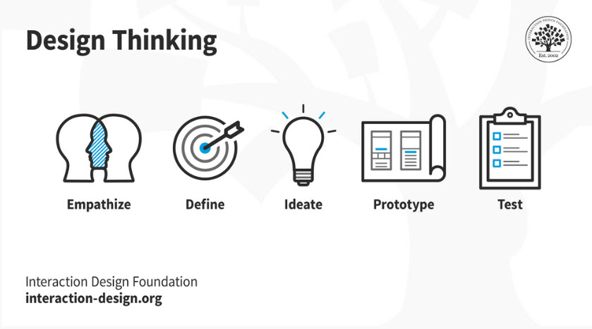
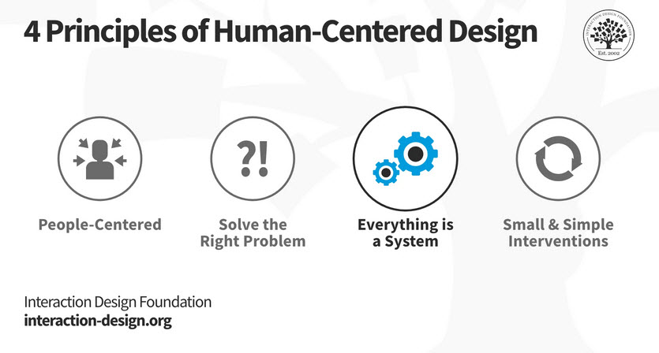
Analysis approach

Slide 5
The Project Team
A Project Manager with project management experience who would oversee start to finish
A Project Steering Team to set direction and make key decisions
A Functional Consultant with HR experience who would understand business processes and functions
A Technical Consultant to focus on the technical aspects of designing, building, and testing solutions.

Slide 6
Next Steps
Agree final project team and customer stakeholder representatives
Project planning and set-up
Hold project kick-off
Prepare for analysis and design work

